Slide 1

Drowsiness Detection Using Video Analysis
AP18110010213 - K. Sree Rama Murthy
AP18110010258 - Vijay Kashyap Kompella
AP18110010252 - K. Aashritha
AP18110010263 - Hemanth Sri Sai Boddupalli
AP18110010246 - Bhavana Siddineni

Slide 2
INTRODUCTION
A large number of individuals in India lose their lives because of Road Accidents.
Insights shows that car accidents all over the world are the ninth reason for death.
Reasons behind road accidents include highway traffic, over speeding, use of cellphones while driving, drunk drivers and drowsiness of drivers.
The “Driver Drowsiness” alone records for around half of these accidents.
Drowsiness is characterized as the center stage between Wakefullness and Rest.
A Drivers Sleepliness state is central point in serious accidents that claims a large number of lives each year.

Slide 3
Statistical Review
Around 1.3 million Individuals die every year accross the Globe and Statistics shows that 10% of crashes are due to frequent yawning, difficulty in keeping eyes open for longer durations, and not maintaining necessary distance between front and back vehicle.
As indicated by the “National Highway Traffic Safety Administration (NHTSA)” there were morethan 72,000 police- reported accidents and estimated 1,00,000 crashes due to drowsy drivers from 2009 to 2013, harming morethan 41,000 individuals and killing morethan 800 individuals.
The “World Health Organisation Global Report” on road security says that India positions first in the world for road accidents in 2018 and it accounts 11% of accidents recorded globally.
According to exploration in India, in 2018, around 1.51 hundred thousand people lost their lives in accidents due to overspeedingof vehicles and drowsiness of drivers.
Our Approch
Our paper focuses on the behavioral-based approach which includes eye monitoring, head positioning, and face detection. The real-time drowsiness is identified with help of a camera and MATLAB software.

Slide 4
Literature Review
Krajweski et al. proposed a vehicle movement-based drowsiness detection system by considering the correlations between the micro-adjustments of the steering wheel and lethargicness.
In another case, Volvo comapred the user driving patterns in drowsy and fully active states by monitoring the position of vehicle with the road
The next class of methods involves the analysis of biological characteristics of users with the help of sensors for EEG, ECG, EOG. The drowsiness detection is based on alpha, beta and theta signals
M. Asjid Tanveer, M. Jawad Khan, M. Jahangir Qureshi, Noman Naseer, and Keum-Shik Hong identified drowsiness by deep learning with the fNIRS framework by engaging DLPFC and PFC's. Deep networks were used to identify awake and sleepy states and these are tested using CNN.

Slide 5
S. Tateno, X. Guan, R. Cao, and Z. Qu built up a framework by observing the pulse of the driver which helps to figure any breath changes.
Voice detection techniques can be utilized to distinguish a fatigued voice of the driver. This thought was proposed by Lakshmi Swathi Dhupati, Sibsambhu Kar, Aparna Rajaguru, and Aurobinda Routray. The voice responses were assessed based on factors like duration, unvoiced length, and reaction time. MFCC and GMM are used for further understanding of the voice forms.
In-Ho Choi, Sung Kyung Hong, Yong-Guk Kim have introduced a theory in which driver's gaze is analyzed utilizing new profound deep learning procedures based on CNN with face recognition through GPU.
Ashish Tawari, Kuo Hao Chen, and Mohan M. Trivedi have considered just the iris status for identifying drowsiness. They proposed a monocular camera-based framework and a robust eye cue estimation-based algorithm.

Slide 6
Proposed Scheme
It is a behavioral approach which mainly focuses on head movement, face and eye detection.
Capturing of live video and extracting snapshots.
Continuous detection is necessary as user can feel drowsy at any instant hence detection process should not stop until the user exits the system.
First step : Face Detection is performed using Viola Jones Algorithm. A rectangular box is created
Second step : Detection of both left and right eyes applying the cropping technique.
1. Consider only the initial face, if multiple faces are detected.
2. Calculate the box coordinates of both the eyes and crop and enlarge them.
3. Depicts the bounding box over the frame.
Third step : Eye Movement Detection by SVM Classifier
1. Extract histogram features and predict the class labels for both the eyes.
2. Based on the predictions classify them as active or blinking.
3. Further return the respective state of each eye.

Slide 7
If both eyes remain closed generate an audio speech prompting the user to open his/her eyes.
Fourth Step: Head movement detection.
1. Continuously calculate the Euclidean distance between the initial frame and
current frame.
2. Compare the calculated value with the threshold value of 5 ( a result
obtained after several experimental observations).
3. If it exceeds the threshold then display a message conveying the detection of
head movement.
Execute this process until the user closes the system.

Slide 8
Algorithm: Drowsiness Detection using video analysis
Input : Live Video Streaming through Webcam
Output : Audio Alert based on drowsiness detection
Setup and initialize webcam object cam, video displayer object vp, viola-jones face detector fd and eye detector ed
Capture one frame and store the frame properties such as size, resolution, and use fd to get bounded box bbox [x, y, width, height] properties of initial face position.
Declare a global assembly for audio alert and instantiate object ss for speech synthesis and change to full volume.
while ┐(system is closed) do
get a Frame from cam
Detect face in Frame using viola-jones algorithm and store face position bounding values in bbox2 [x, y, width, height].
If ((bbox(2)-bbox2(2))^2 + (bbox(1)-bbox2(1)) ^2) ^0.5 > 5 : a) display face is moving b) Give low volume sound alert
Update bbox=bbox2
Crop face from Frame. Now calculate ROI for expected eye positions based on standard face ratios
Crop each eye from Frame and store in left and right.
Perform parametrised viola-jones algorithm for eye detection in ROI to get exact eye positions in Frame. Crop these and store in same variables
Extract HOG features from each eye image and feed it to the SVM classifier which will resturn a binary result for each eye in Lresult, Rresult.
Initialise left message L, right message R, and drowsiness status D as “left eye: closed”, “right eye: closed” and “Blinking”. Set box color to yellow.
If Lresult=1 or Rresult=1: set D=”awake”
Else: Give full volume sound alert “Please open your eyes” and change box color to red.
If Lresult=1: set L=” left eye: open”
If Rresult=1: set R=” right eye: open”
Insert rectangle over face, eyes in Frame and add timestamp, messages L, R, D at top left of Frame
Append Frame to the videoplayer object.
End of while in step 4

Slide 9
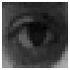
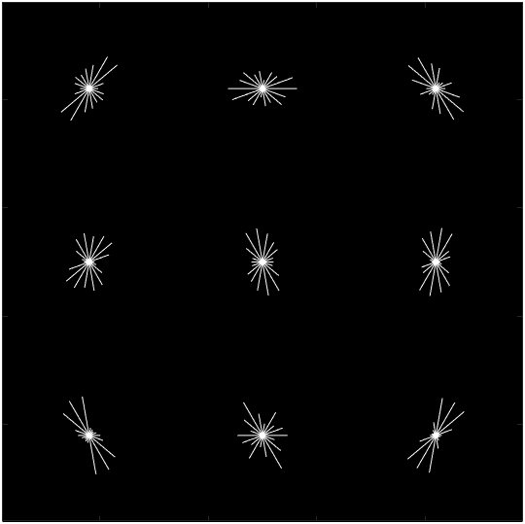
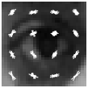
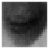
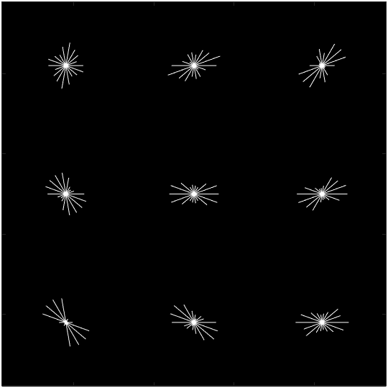
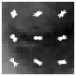
Eye states and their HOG features
(a) Open Eye HOG features
(b) Closed Eye HOG features

Slide 10
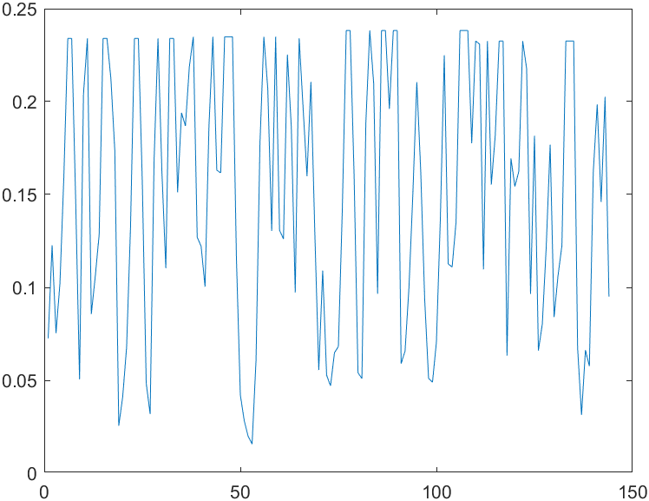
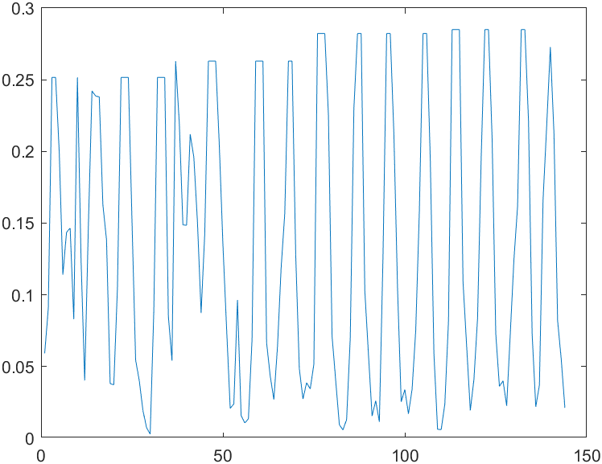
Plot of HOG Feature
(a) Open eye
(b) Closed eye

Slide 11
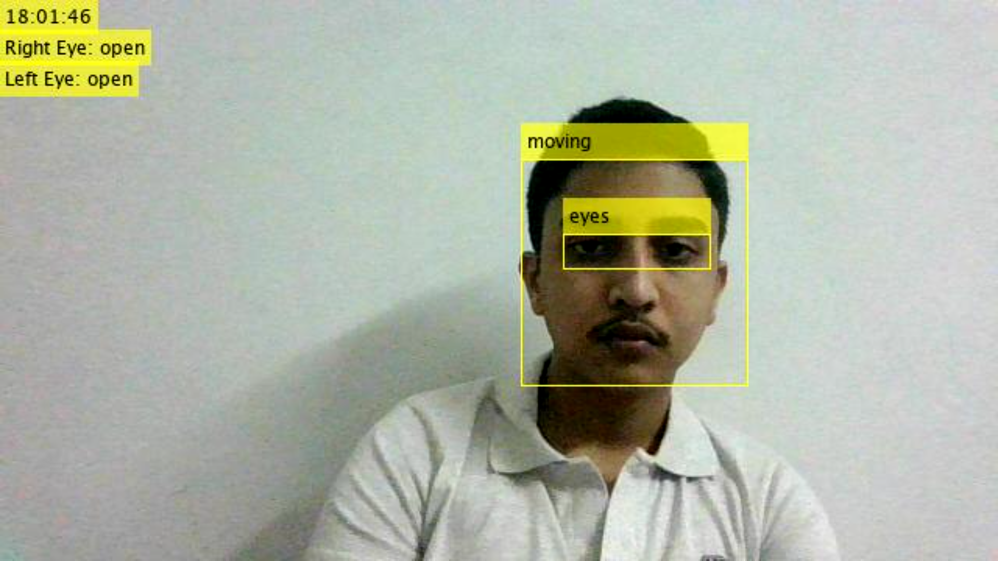
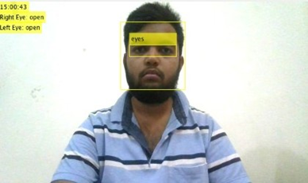
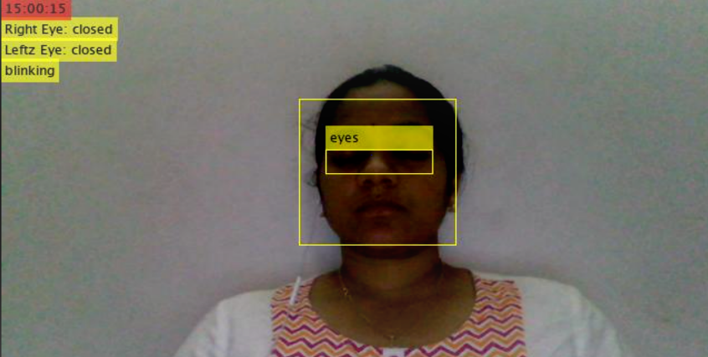
Experimental Study
Frame | Desired Output | Experimenatl Output
 | Face status : Moving Right eye : open Left eye : open Drowsiness : No | Face status : Moving Right eye : open Left eye : open Drowsiness : No Result : Accurate
 | Face status : Not Moving Right eye : open Left eye : open Drowsiness : No | Face status : Not Moving Righteft eye : open Left eye : open Drowsiness : No Result : Accurate
 | Face status : Not moving Right eye : closed Left eye : closed Drowsiness : Yes | Face status : Not moving Right eye : closed Left eye : closed Drowsiness : Yes Result : Accurate

Slide 12
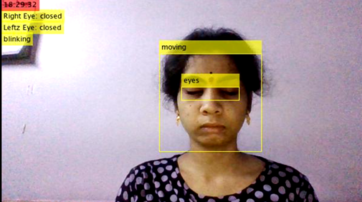
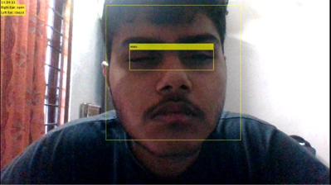
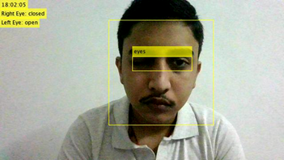
 | Face status : Moving Right eye : closed Left eye : closed Drowsiness : Yes | Face status : Moving Right eye : closed Left eye : closed Drowsiness : Yes Result : Accurate
 | Face status : Not Moving Right eye : open Left eye : closed Drowsiness : No | Face status : Moving Right eye : open Left eye : closed Drowsiness : Yes Result : Accurate
 | Face status : Not Moving Right eye : closed Left eye : open Drowsiness : No | Face status : Moving Right eye : closed Left eye : open Drowsiness : Yes Result : Accurate

Slide 13
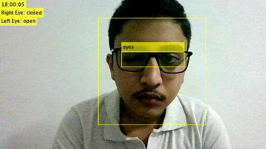
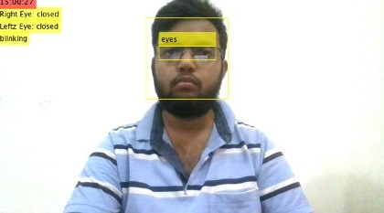
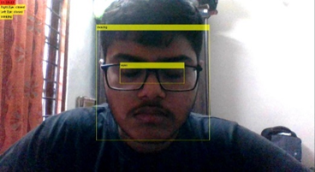
ljlnjn | Face status : Moving Right eye : closed Left eye : open Drowsiness : No | Face status : Moving Right eye : closed Left eye : open Drowsiness : No Result : Accurate
 | Face status : Not Moving Right eye : open Left eye : open Drowsiness : No | Face status : Moving Right eye : closed Left eye : closed Drowsiness : No Result : Not Accurate
 | Face status : Not Moving Right eye : closed Left eye : closed Drowsiness : No | Face status : Moving Right eye : closed Left eye : closed Drowsiness : No Result : Accurate
Person with Big Frame Spectacles
Person with Small Frame Spectacles
Person with Big Frame Spectacles

Slide 14
Result Analysis
The program compiled and ran Succesfully.
It accurately detected face, eyes, face horizontal and vertical movement, left eye, right eye, closedness of left eye, closedness of right eye and inferred drowsiness state.
Face movement was detected in all frames, including Bright and Dim Lighting.
Eye detection Failed if the eyes are Not Fully Visible in frame.
e.g: in case of small frame spectacles.
If drowsiness is detected an Audio Alert is succesfully given to alert the driver.
In case the eyes or face are not properly detected, as a safety precaution we mark it as drowsiness detected because a false positive is tolerated but a false negative is fatal.

Slide 15
Conclusion
We have introduced a drowsiness detection algorithm based on behavioral-based approch and image processing. It moniters and detects any head movements and classifies each eye open or closed.
We have used Viola-jones Algorithm for face detection and calculated a distance between position of face and consecutive frames. If the distance is greater than threshold value we infer that the face is moving. For eye monitering we have utilised a pre-trained SVM classifier model.
The Status of both eyes open or closed is displayed along with a timestamp.
If head movement is detected a warning message is diaplayed on screen with low volume audio alert. If both eyes are closed then a full volume audio alert is given to alert the driver.
It fails to detect the eye closedness when eyes are not fully visible eg: wearing small frame spectacles. We plan to overcome this drawback in our future works by point tracking analysis combined with MaxBidirectional error.

Slide 16
References
Kolpe, Pratiksha and Kadam, Pratibha and Mashayak, Usama, Drowsiness Detection and Warning System Using Python (May 13, 2020). 2nd International Conference on Communication & Information Processing (ICCIP) 2020﻿, Available at SSRN: https://ssrn.com/abstract=3645864 or http://dx.doi.org/10.2139/ssrn.3645864
P. R. B. Agustin, R. C. Lazaro, M. D. L. Mazo, A. C. P. Vidal, E. Q. Raguindin and M. A. C. Purio, "MATLAB based drowsiness detection system using an array of sensors and fuzzy logic," TENCON 2014 - 2014 IEEE Region 10 Conference, Bangkok, Thailand, 2014, pp. 1-6, doi: 10.1109/TENCON.2014.7022353.
M. Omidyeganeh, A. Javadtalab and S. Shirmohammadi, "Intelligent driver drowsiness detection through fusion of yawning and eye closure," 2011 IEEE International Conference on Virtual Environments, Human-Computer Interfaces and Measurement Systems Proceedings, Ottawa, ON, Canada, 2011, pp. 1-6, doi: 10.1109/VECIMS.2011.6053857.
B. N. Manu, "Facial features monitoring for real time drowsiness detection," 2016 12th International Conference on Innovations in Information Technology (IIT), Al Ain, United Arab Emirates, 2016, pp. 1-4, doi: 10.1109/INNOVATIONS.2016.7880030.
Y. Suryawanshi and S. Agrawal, "Driver Drowsiness Detection System based on LBP and Haar Algorithm," 2020 Fourth International Conference on I-SMAC (IoT in Social, Mobile, Analytics and Cloud) (I-SMAC), Palladam, India, 2020, pp. 778-783, doi: 10.1109/I-SMAC49090.2020.9243347.
A. Picot, S. Charbonnier and A. Caplier, "Drowsiness detection based on visual signs: blinking analysis based on high frame rate video," 2010 IEEE Instrumentation & Measurement Technology Conference Proceedings, Austin, TX, USA, 2010, pp. 801-804, doi: 10.1109/IMTC.2010.5488257
In-Ho Choi, Sung Kyung Hong and Yong-Guk Kim, "Real-time categorization of driver's gaze zone using the deep learning techniques," 2016 International Conference on Big Data and Smart Computing (BigComp), Hong Kong, China, 2016, pp. 143-148, doi: 10.1109/BIGCOMP.2016.7425813
M. A. Tanveer, M. J. Khan, M. J. Qureshi, N. Naseer and K. Hong, "Enhanced Drowsiness Detection Using Deep Learning: An fNIRS Study," in IEEE Access, vol. 7, pp. 137920-137929, 2019, doi: 10.1109/ACCESS.2019.2942838.
L. S. Dhupati, S. Kar, A. Rajaguru and A. Routray, "A novel drowsiness detection scheme based on speech analysis with validation using simultaneous EEG recordings," 2010 IEEE International Conference on Automation Science and Engineering, Toronto, ON, Canada, 2010, pp. 917-921, doi: 10.1109/COASE.2010.5584246.
A. Tawari, K. H. Chen and M. M. Trivedi, "Where is the driver looking: Analysis of head, eye and iris for robust gaze zone estimation," 17th International IEEE Conference on Intelligent Transportation Systems (ITSC), Qingdao, China, 2014, pp. 988-994, doi: 10.1109/ITSC.2014.6957817.
S. Tateno, X. Guan, R. Cao and Z. Qu, "Development of Drowsiness Detection System Based on Respiration Changes Using Heart Rate Monitoring," 2018 57th Annual Conference of the Society of Instrument and Control Engineers of Japan (SICE), Nara, Japan, 2018, pp. 1664-1669, doi: 10.23919/SICE.2018.8492599.

Slide 17

Thank You!

